Slide 1
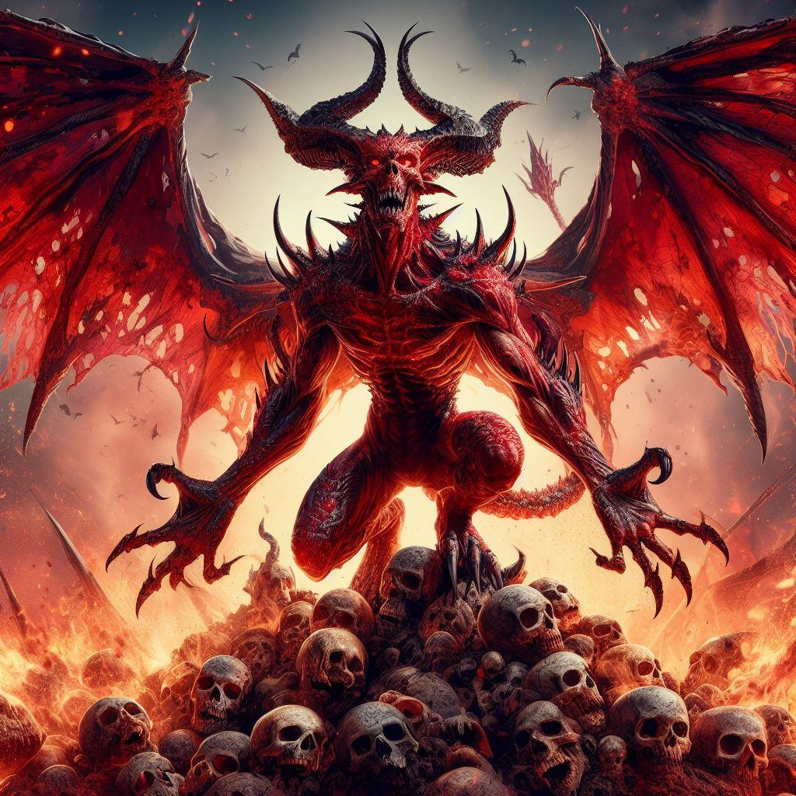
Revenge of
the Red Demon
Kazuya and Taiyo

Slide 2

Gameplay Overview
・Players control a terrifying character called 'Red Demon’.
・'Red Demon' is an inverted horror game that hunts down other characters and creates fear and suspense. The game develops its own storyline, gradually revealing why the player has become a red devil and why he attacks the villagers. The unpredictable and shocking development of the game draws players in.
・Players have to think strategically when attacking villagers as red devils.
・One of the game's aims is to provide players with an authentic and psychological fear experience.
・This gameplay time is around 5-10 hours. Single-player and multi-player modes. 3D is the best.

Slide 3
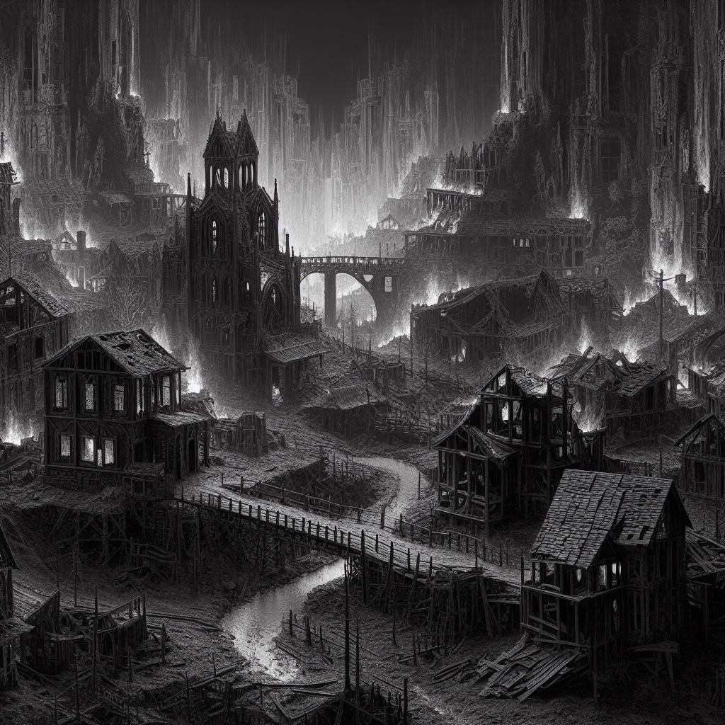
USP’s
・In Red Demon, the player has a reversed role in the story, where he or she is not the normal protagonist, but the red devil. The new perspective of the player attacking the villagers is a unique and surprising element in a horror game.
・The game will be set in traditional Japanese landscapes and architecture, combining the beauty and eeriness of the Japanese style. For example, old temples, forests, and Japanese gardens will be the setting for horror.
・The choices players make, such as whether and how they attack villagers, influence the story and its ending. This emphasises the element of the story changing depending on the player's actions and increases replayability.

Slide 4
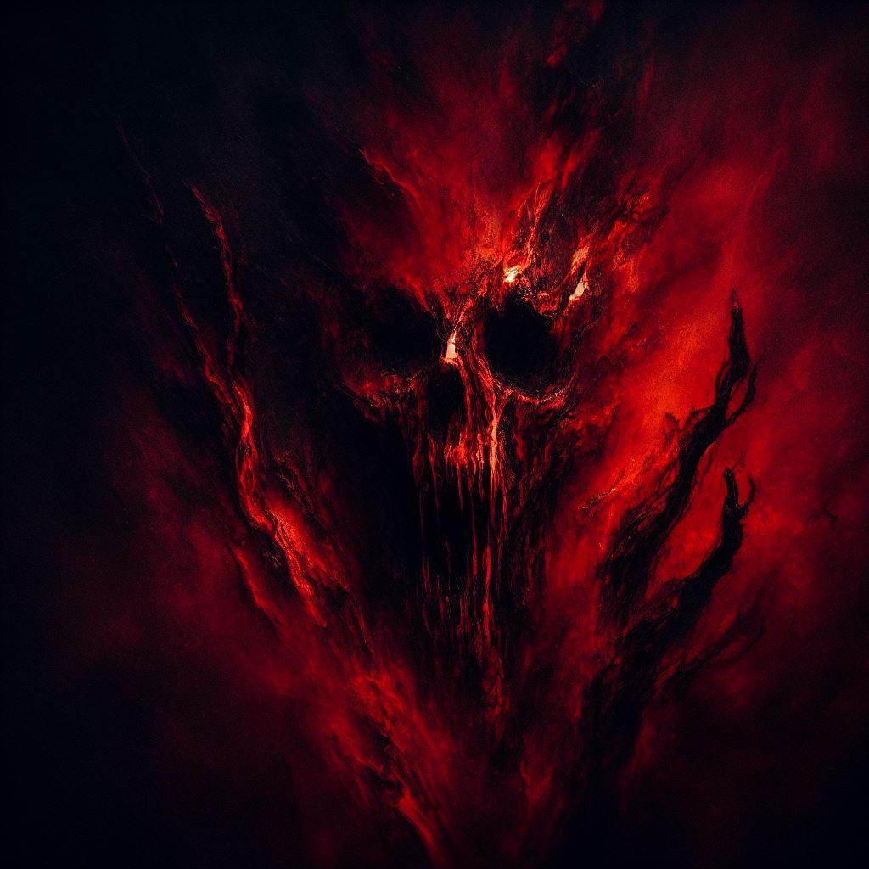
Coming soon

Slide 5

Business model and competition
・The planned platform for release is Switch and PlayStation at a price of 25€
・We base this on similar games such as “Friday the 13th”, which sold approximately USD 52 million at the same price.

Slide 6
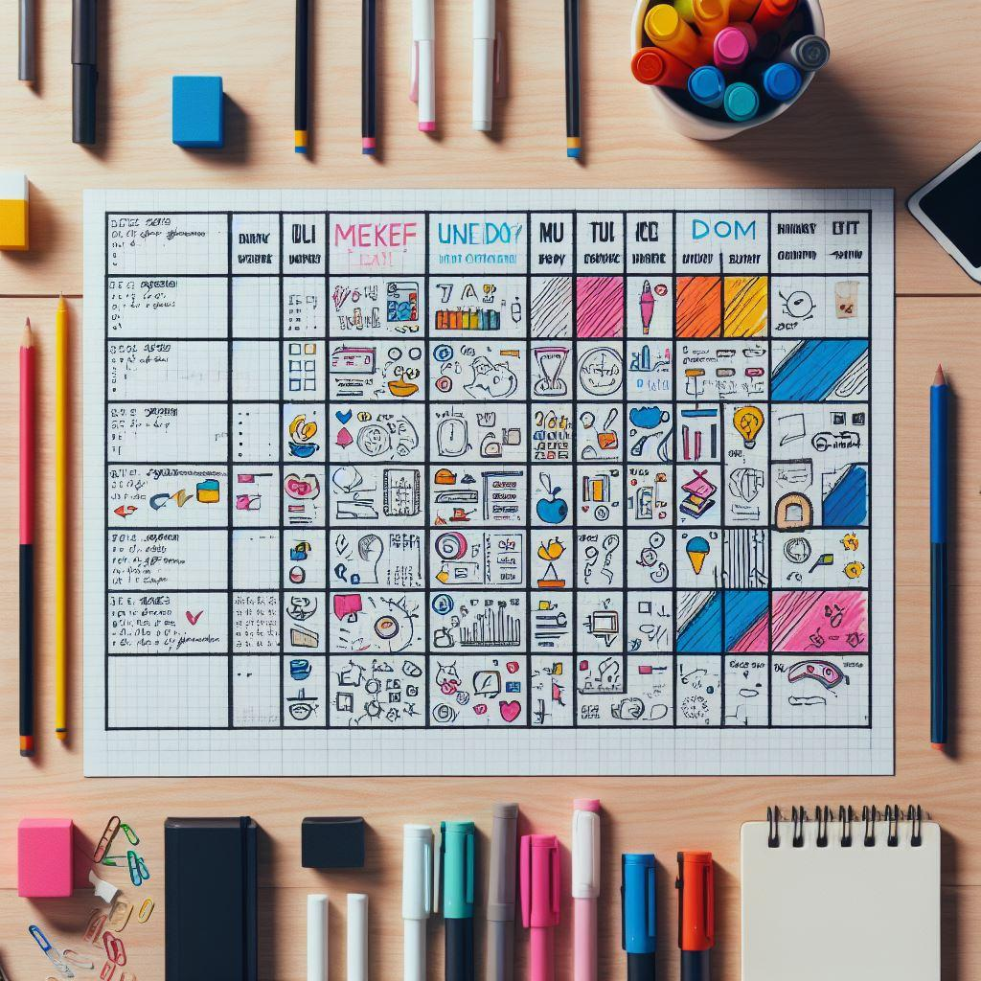
Production Timetable
STEP1：Planning(2～3months)
STEP2：Design(2～3months)
STEP3：Implementation and testing(2～3months)
STEP4：Completion(1months)

Slide 7

Contact Information
Mail:red_demon@gamil.com
Phone:(01)234567
Web:http://www.com.red_demon

